Slide 1
Open Set Recognition Using Neural Networks
Michael Smith
CSCE 823 – 8 Aug 2022

Slide 2
Outline
What is Open Set Recognition?
Problems working with Open Sets in Machine Learning
Overview of OpenGAN data augmentation method
Demo of OpenGAN PyTorch project
Optional: Overview of Class Anchor Clustering

Slide 3
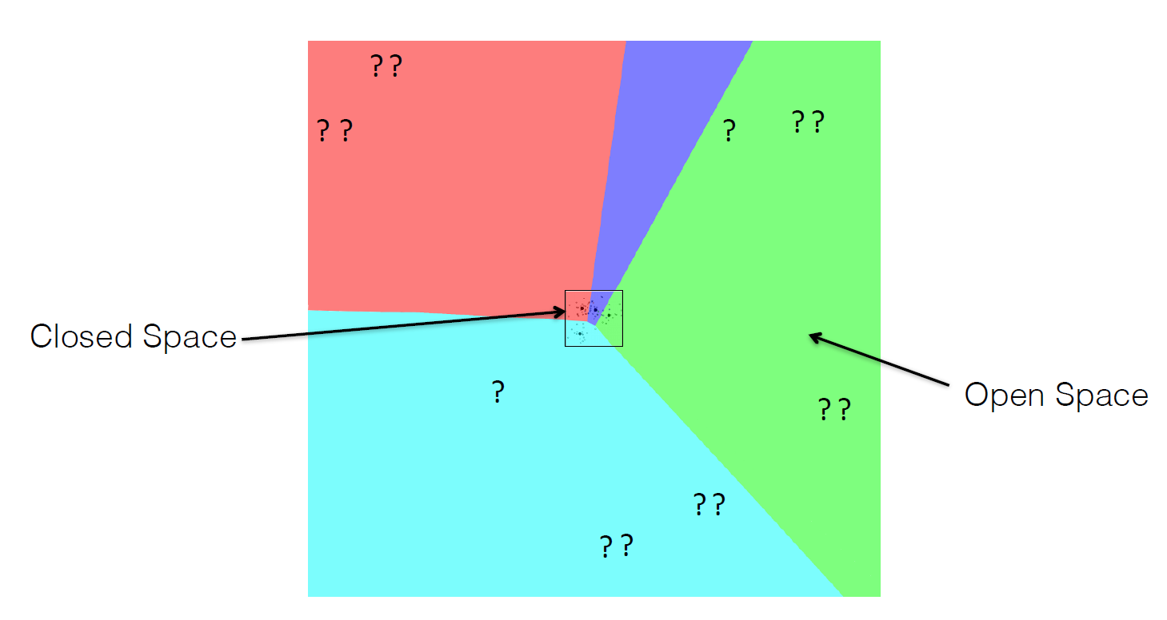
What is Open Set Recognition?
256 colors ^ 3 channels = 16,777,216 colors; 64 pix * 64 pix = 4096 pixels
Total combinations = 16,777,216 ^ 4096; (only 10^80 atoms in the universe)

Slide 4
What is Open Set Recognition?
Testing on data with more classes than are in the training set

Slide 5
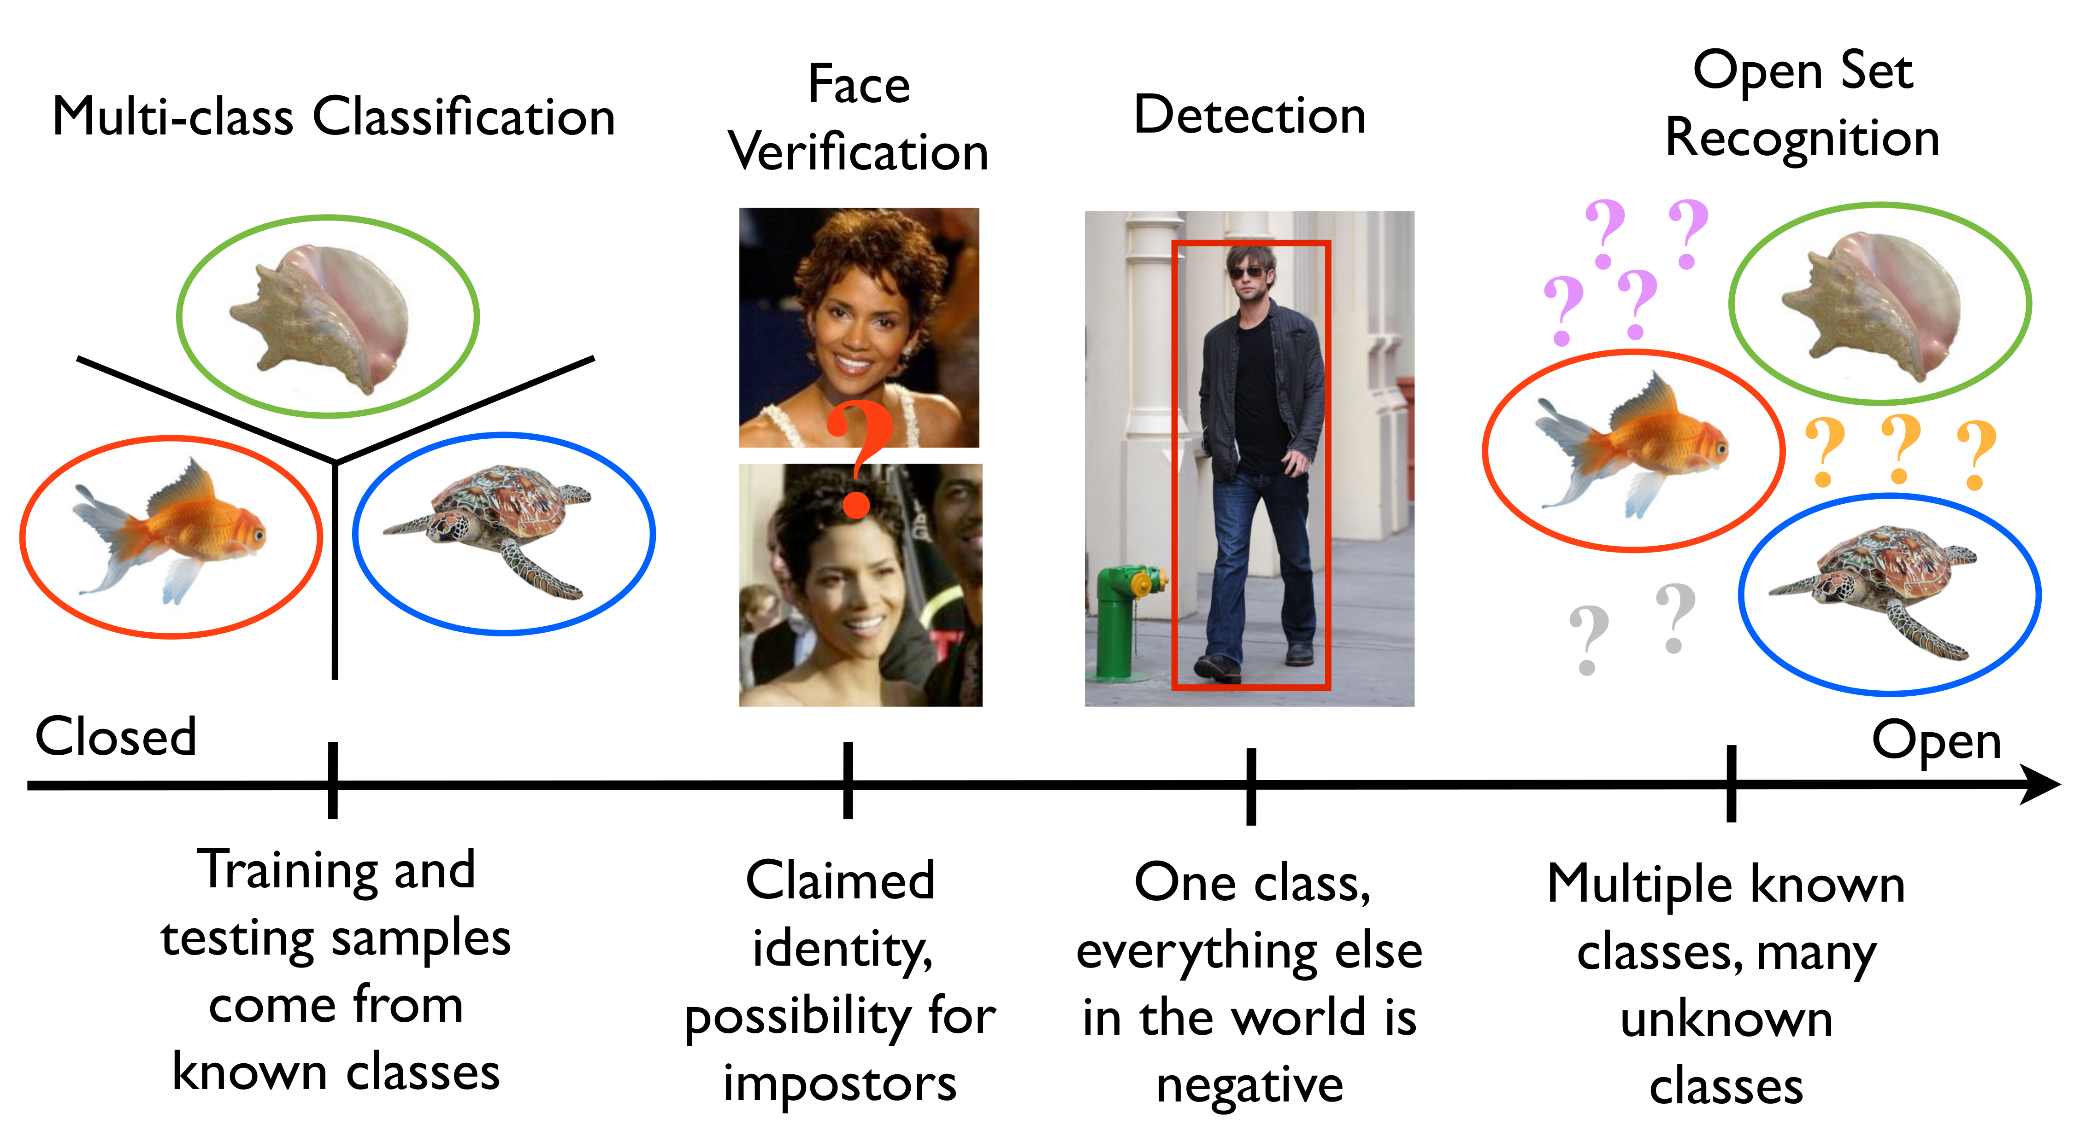
What is Open Set Recognition?

Slide 6
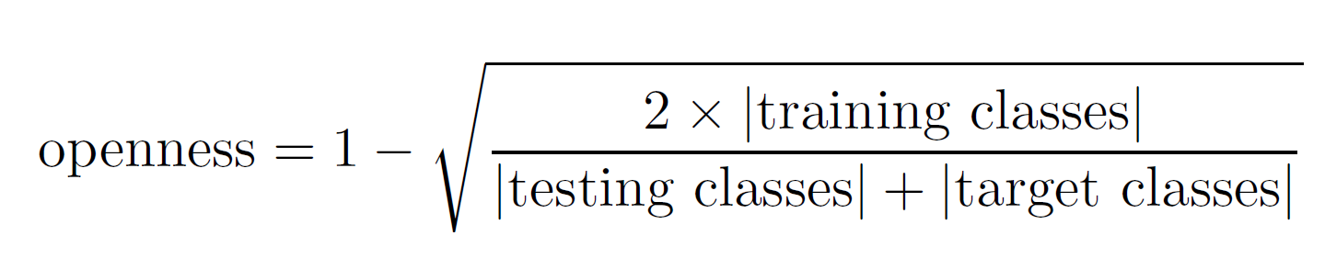
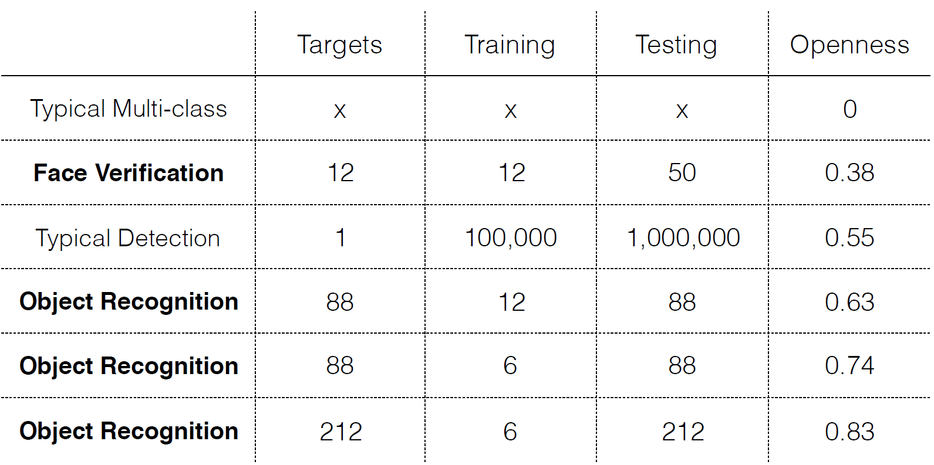
What is Open Set Recognition?

Slide 7
Problems working with Open Sets in ML
All classified with > 99.6% confidence!

Slide 8
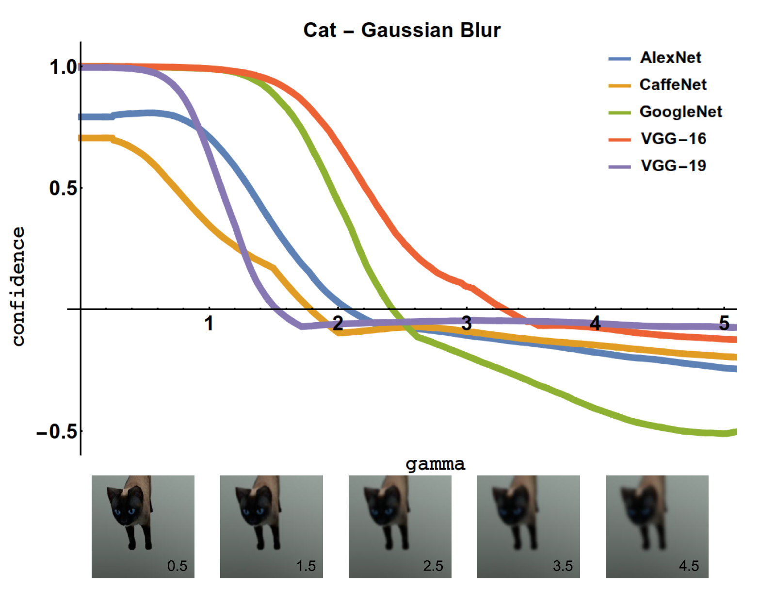
Problems working with Open Sets in ML

Slide 9
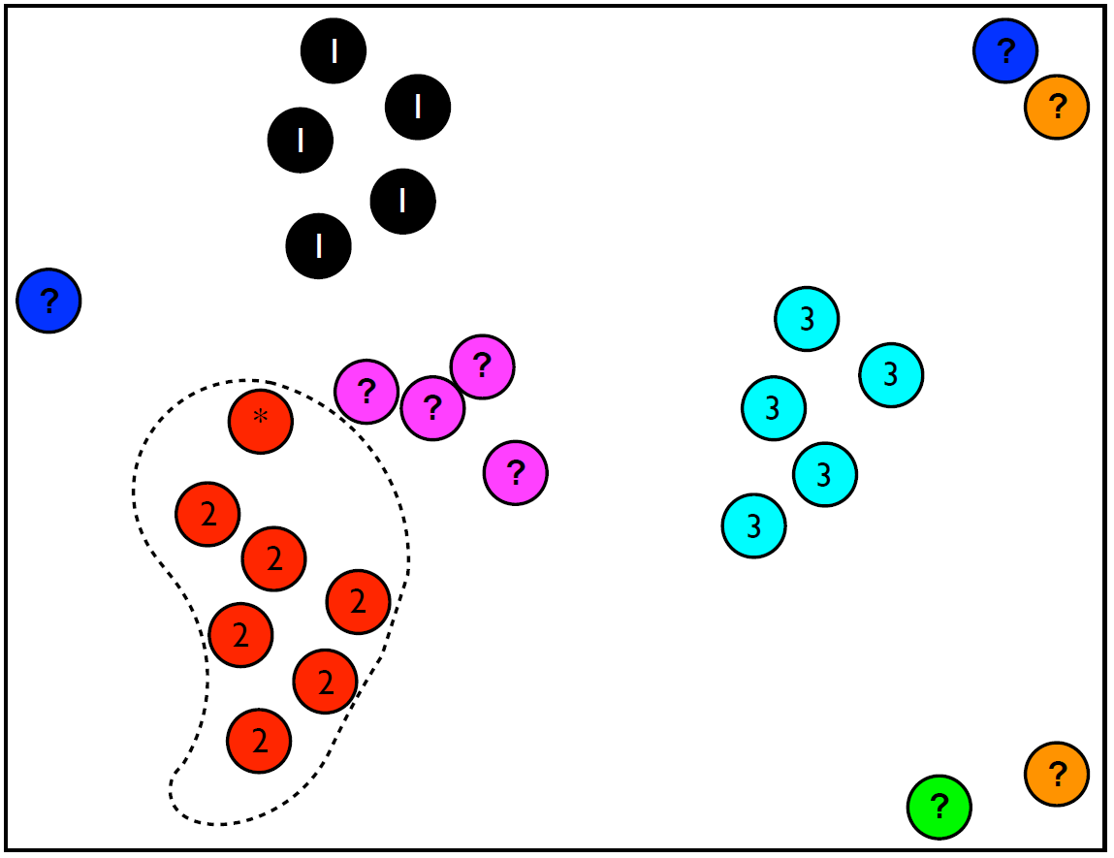
Problems working with Open Sets in ML
Binary
Multi-class 1-v-All
1-class

Slide 10
Quiz Time!
Provide one example of how a deployed ML algorithm could be exposed to an input belonging to the open set

Slide 11
OpenGAN Overview
The problem…

Slide 12
OpenGAN Overview
Architecture

Slide 13
OpenGAN Overview

Slide 14
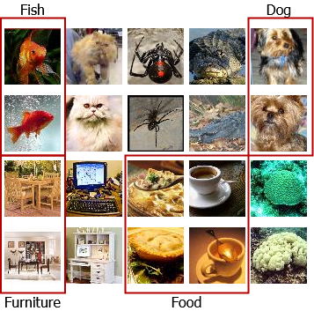
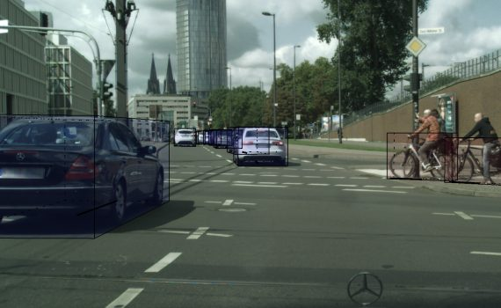
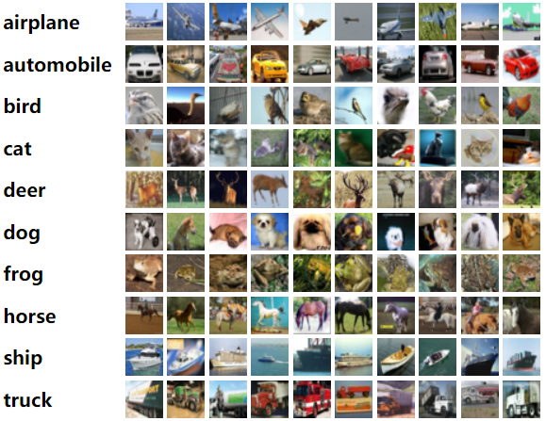
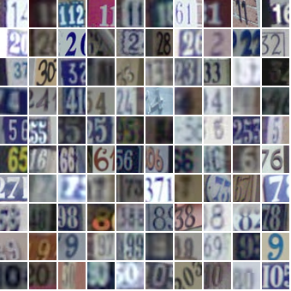
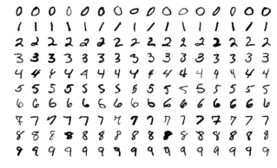
OpenGAN Overview
Tiny ImageNet: 100,000 images, 200 classes, 64×64 pixels
Cityscapes: 5000 images with high quality annotations; 20,000 images with coarse annotations; 50 different cities
CIFAR10: 60,000 images, 10 classes, 32x32 pixels
SVRN: 100,000 images 10 classes, 32x32 pixels
MNIST: 70,000 images, 10 classes, 32 x 32

Slide 15
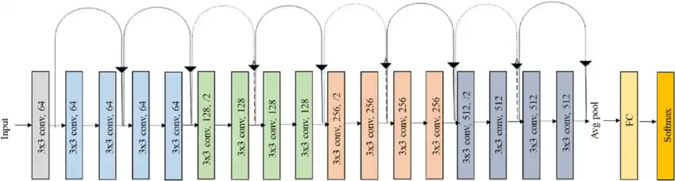
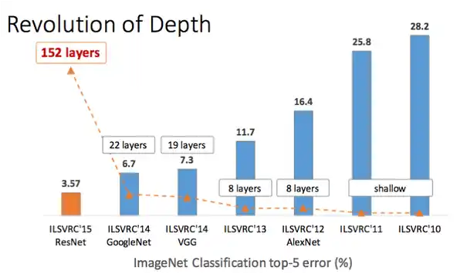
OpenGAN Overview
ResNet18 CNN
Skip connections

Slide 16
OpenGAN Demo
Does not include the closed set trained models so can’t use as is
Requires downloads of all the datasets used

Slide 17
Quiz Time!
What is the advantage of Skip Connections?

Slide 18
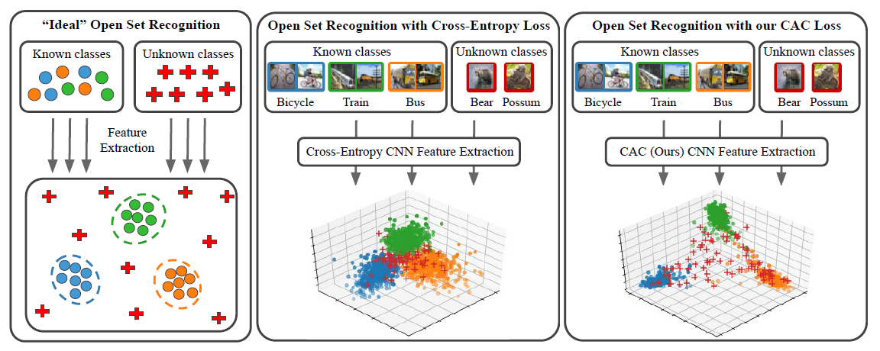
Optional: Class Anchor Clustering Loss

Slide 19
References
Open Set Recognition: https://www.wjscheirer.com/misc/openset/
OpenGAN Paper: https://arxiv.org/abs/2104.02939
OpenGAN Demo Code: https://github.com/aimerykong/OpenGAN
Class Anchor Clustering Paper: https://arxiv.org/abs/2004.02434
Class Anchor Clustering Demo Code: https://github.com/dimitymiller/cac-openset
Resnet Architecture:
https://towardsdatascience.com/understanding-and-coding-a-resnet-in-keras-446d7ff84d33
https://www.researchgate.net/figure/Original-ResNet-18-Architecture_fig1_336642248
Deep Neural Networks are Easily Fooled: https://arxiv.org/abs/1412.1897

